Slide 1

Music Store Data Analysis

Slide 2




I enjoy talking about Data..
Aryan Madchetti
B.Tech, Computer Engineering
DY Patil University, Pune, Ambi

Slide 3

- THE MUSIC STORE
This project focuses on analyzing a real-world music store database using SQL. The goal was to design a relational schema, import data from CSV files, and write optimized queries to extract actionable business insights. Through this, I practiced key database skills like data modeling, joins, aggregations, and subqueries—answering questions around customer behavior, revenue trends, and popular music genres, etc.

Slide 4
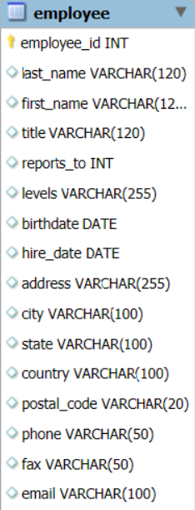
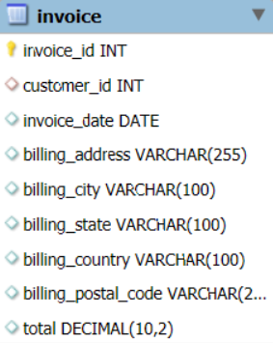
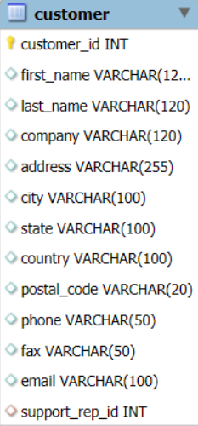
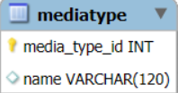
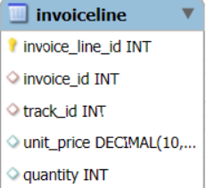
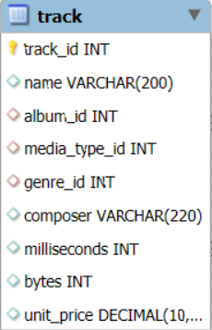
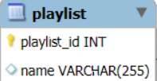
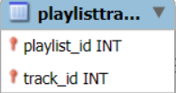
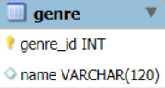
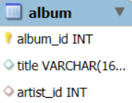
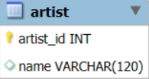
ER Diagram and Scheme Explanation :

Slide 5
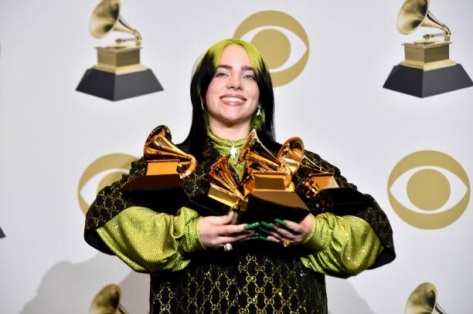



Use Case :
We can host a NIRVANA AWARDS CEREMONY / MUSIC FESTIVAL

Slide 6
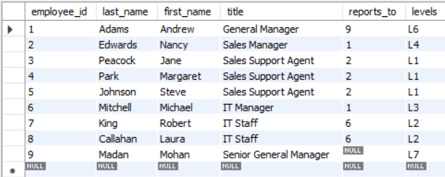
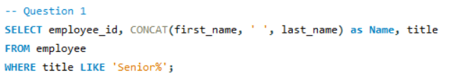

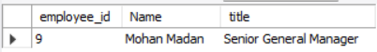
Who is the senior most employee based on job title?

Slide 7
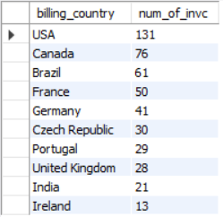
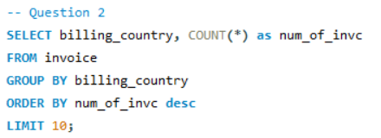
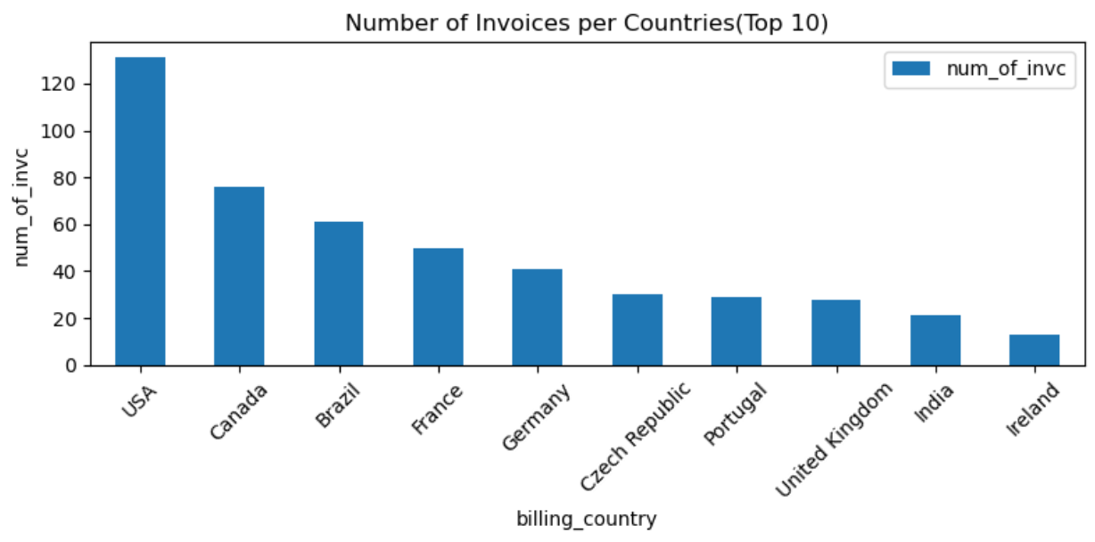
Which countries have the most Invoices?
Total number of countries: 24
Total number of Invoices: 614

Slide 8
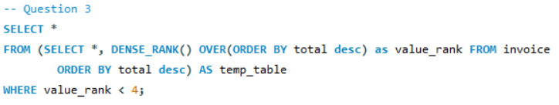
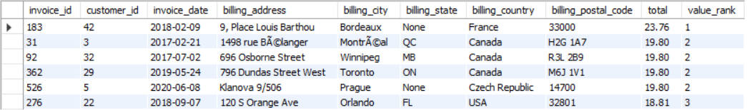
What are the top 3 values of total invoice?
Total number of invoices: 614
Total distinct values of invoices: 21
Minimum value in total: 0.99
Maximum value in total: 23.76

Slide 9
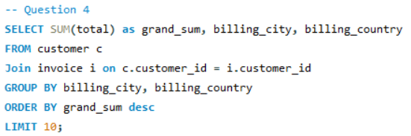
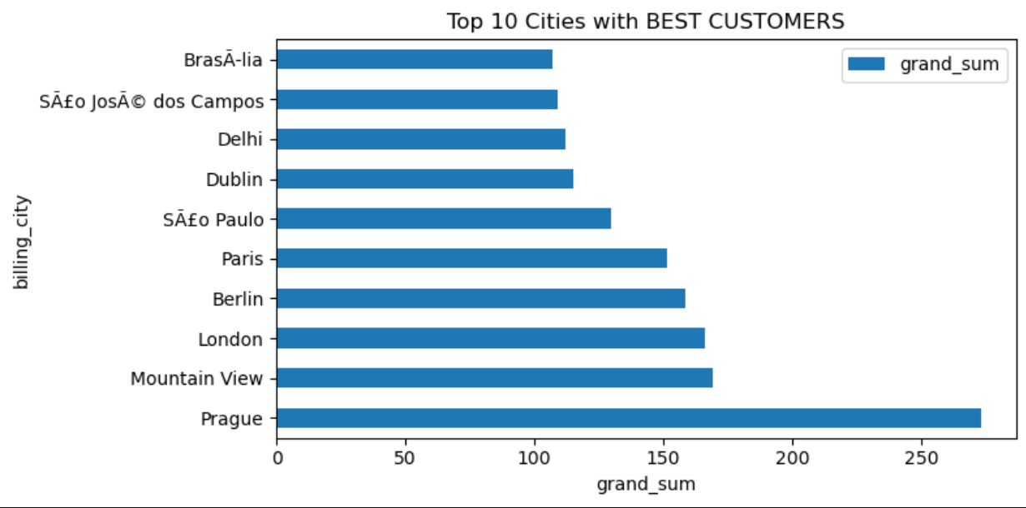

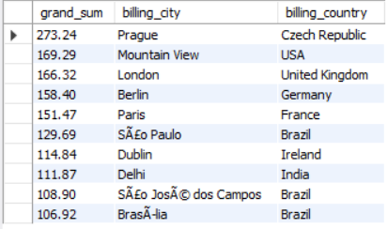
Which city has the best customers?

Slide 10



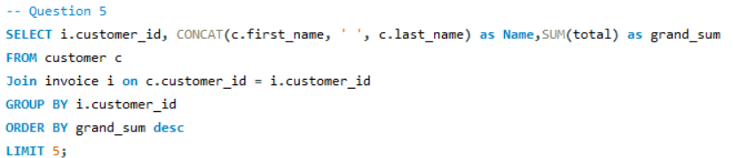
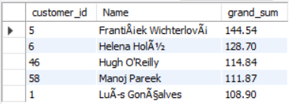
Who are the best customers?
Total number of customers: 59
Total spent by all the customer: 4709.43

Slide 11


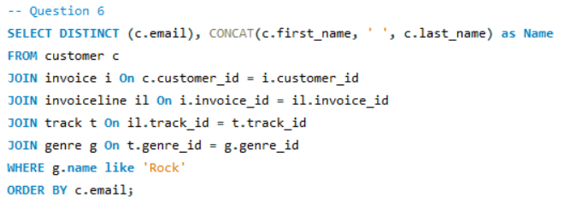
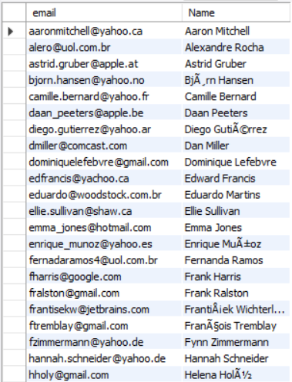

List of all the Rock Music Listeners.
Total count of Rock Music Listener : 59
Total count of listeners/customers : 59

Slide 12
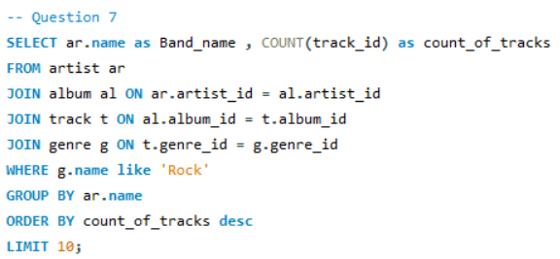
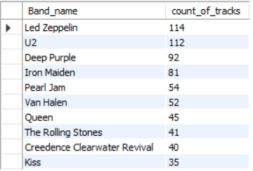
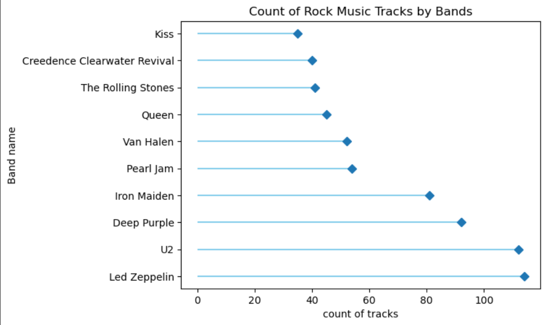

List of Artists/Bands who make Rock Music.

Slide 13




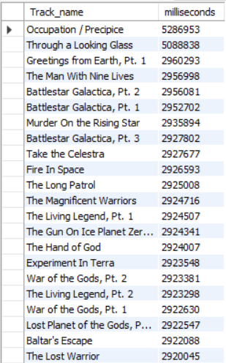

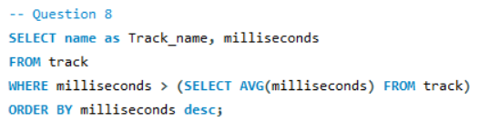
All the track names that have a song length longer than the average song length.
Total count of tracks which have length longer than the average : 494
Total count of all tracks : 3503

Slide 14
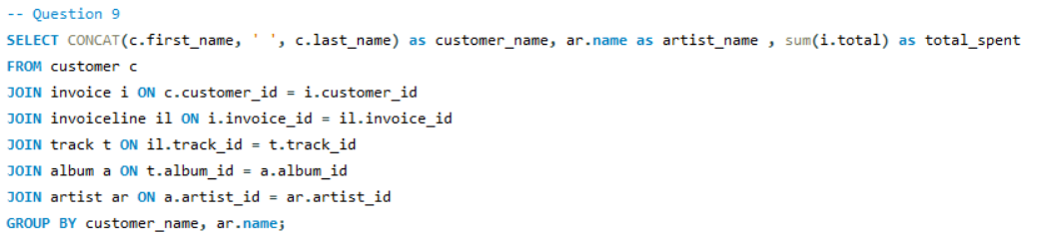
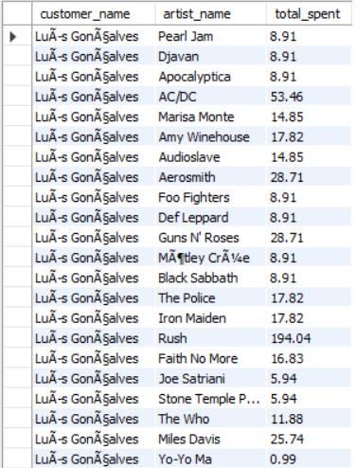
List of amount spent by each customer on artists.
Length of the result table : 4757
LuÃ­s GonÃ§alves spent on 110 artists
Mark Philips is the customer who spent on the fewest number of artists : 30
FrantiÅ¡ek WichterlovÃ¡ is the customer who spent on the most number of artists : 146

Slide 15
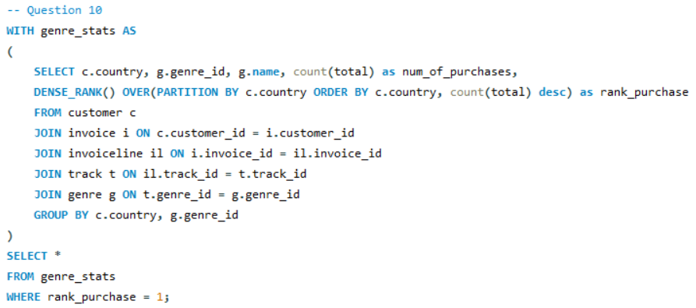
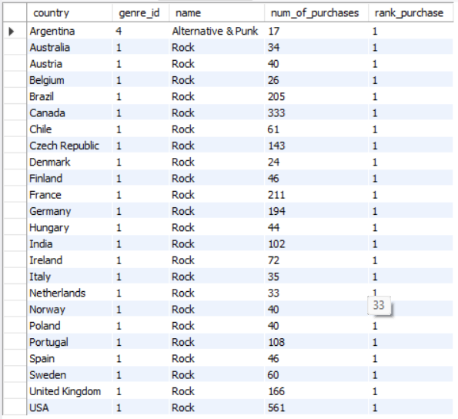
The most popular music Genre for each country.
Number of distinct countries : 24
Number of distinct genres : 25

Slide 16
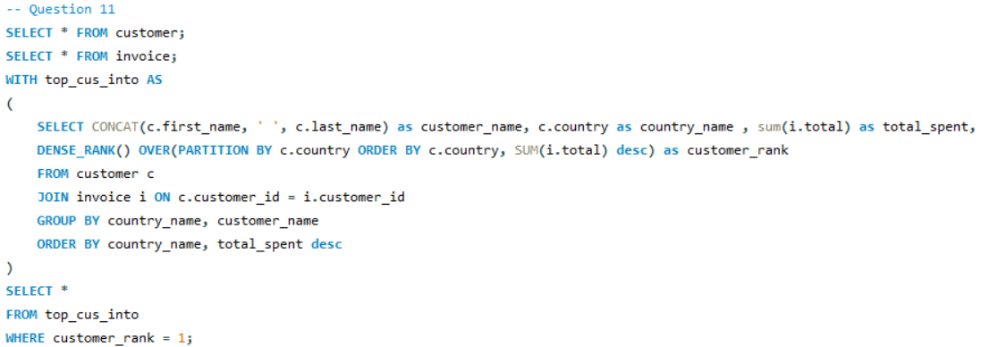
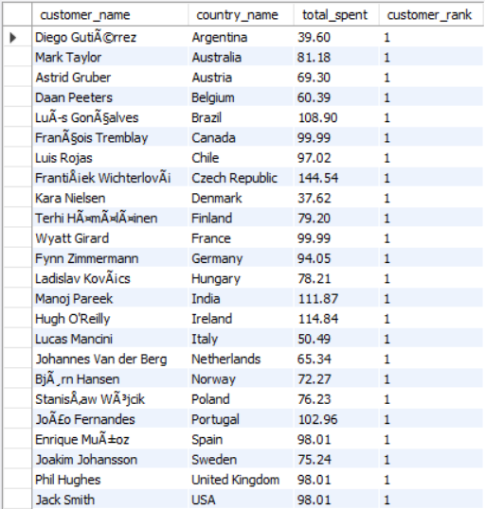
List of customer that has spent the most on music for each country.

Slide 17
Conclusion :
We saw how we can know about various trends and top rankings based on using specific filters can be obtained. Similarly, we can host different awards for the diverse categories through out cities and countries.
Insights from this analysis can support better customer targeting, event planning , and inventory decisions based on popular genres/artists.
This project strengthened my ability to translate raw data into meaningful business intelligence using SQL.

Slide 18

Any Questions

Slide 19
Experience and Challenges Faced:
Difficulty in importing large dataset (track.csv) into SQL using wizard.
Challenges while writing Join and Sub-queries.

Slide 20

THANK
YOU !

